Slide 1
Digital Logic Design
Lecture 4
Dr. Gamal Fahmy
Karnaugh Maps
© Gamal Fahmy

Slide 2
Karnagh Maps
Signed Numbers
XOR
© Gamal Fahmy

Slide 3
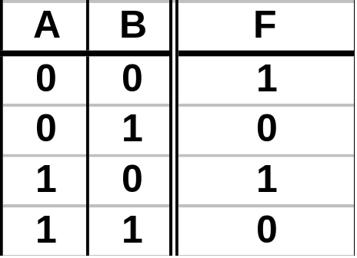
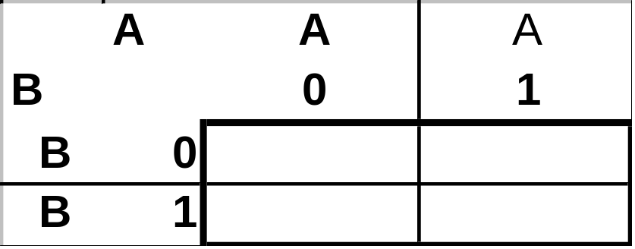
Karnaugh Maps
Karnaugh Map Method: A visual method for identifying adjacency groups of 1’s or 0’s.
Karnaugh Map: A grid used to store truth table data in an efficient form.
1
1
F=B
0
0
© Gamal Fahmy

Slide 4
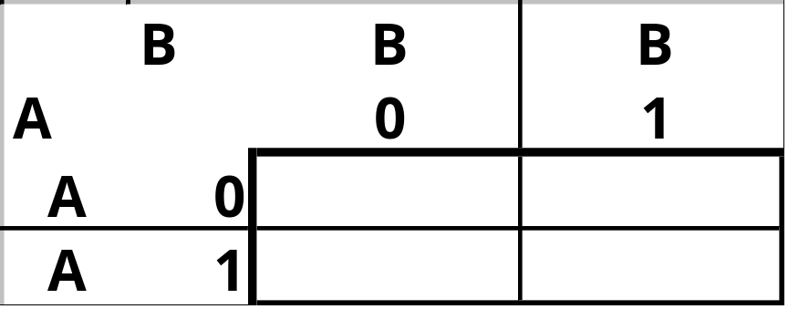
Karnaugh Maps
Adjacency groups that are valid must have 2k elements. (`1,2,4,8,16 etc.)
Some groups with 2, 4, etc elements are NOT adjacency groupings. Example
© Gamal Fahmy

Slide 5
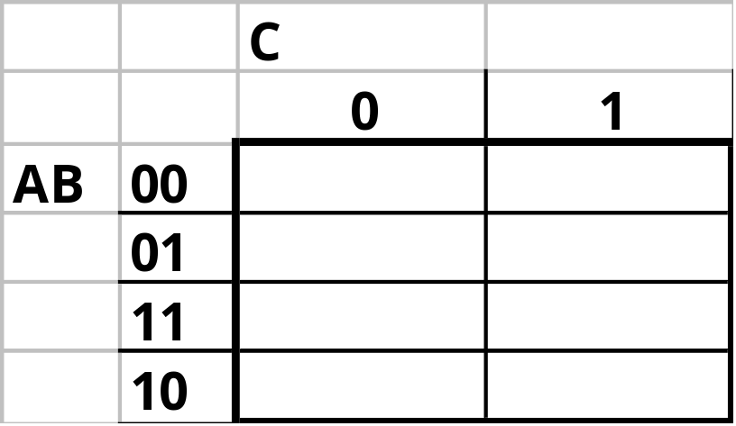
Karnaugh Maps
Q? How many Boolean Cubes on a 3 variable Karnaugh Map?
Note the ordering on AB axis.
A: Many.
© Gamal Fahmy

Slide 6
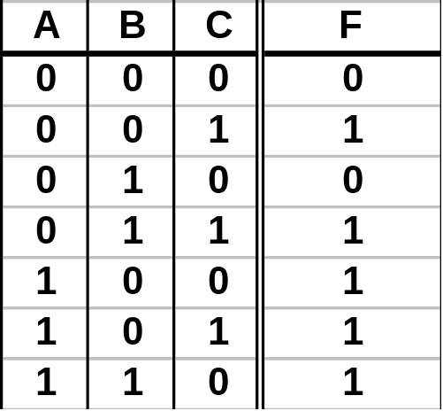

Karnaugh Maps
0
1
0
1
1
1
1
1
What is PI and EPI
F=A
+C
© Gamal Fahmy

Slide 7
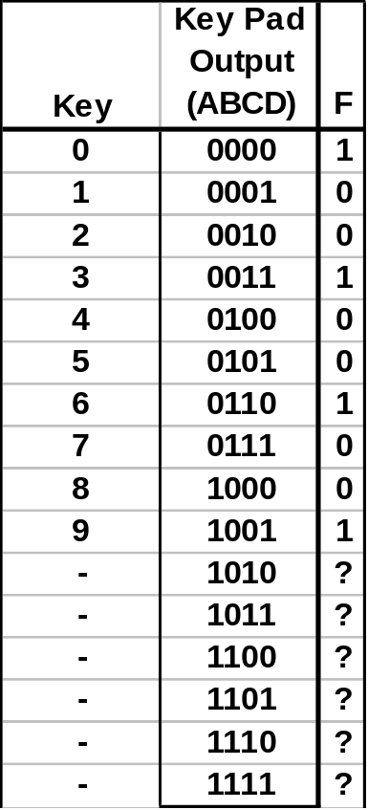
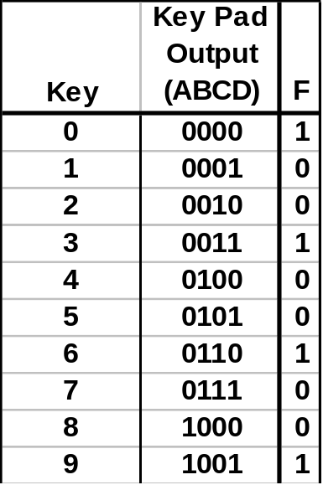
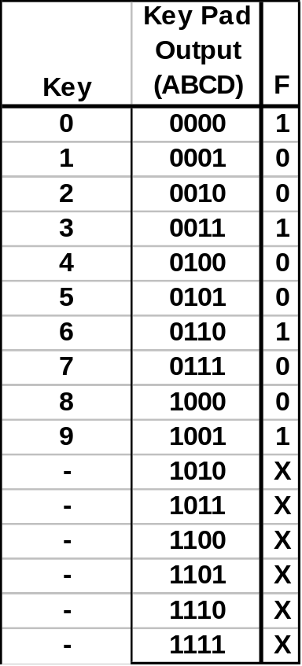
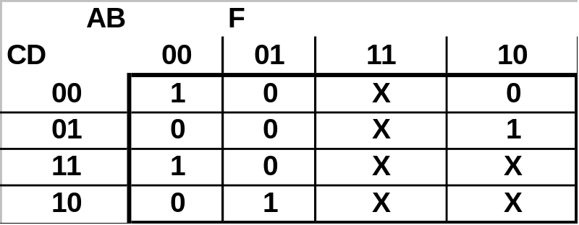
Karnaugh Maps
Don’t Cares: Values assigned to a function for input combinations that can’t occur.
Decimal Keypad
F ={1 if key is multiple of 3,
0 otherwise}
1 2 3
4 5 6
7 8 9
4
Combinational
Logic
F
0
© Gamal Fahmy

Slide 8
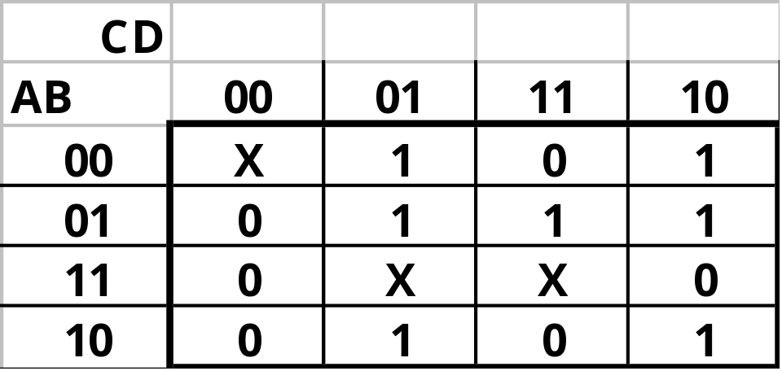
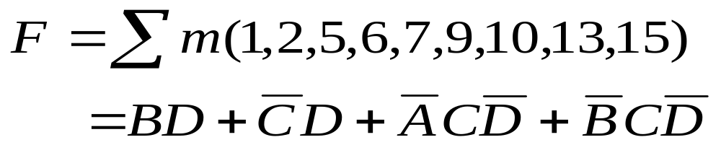
Karnaugh Maps
Find the Min SOP for the following 4-variable function:
    Don’t Cares (X) may be grouped as 1’s or 0’s but not both.
© Gamal Fahmy

Slide 9
Karnaugh Maps
What is PI and EPI
© Gamal Fahmy

Slide 10
Karnaugh Maps
Using Karnaugh Maps to minimize functions by grouping 1’s gave a Min SOP Form:
Using Karnaugh Maps to minimize functions by grouping 0’s gives a Min POS Form:
© Gamal Fahmy

Slide 11
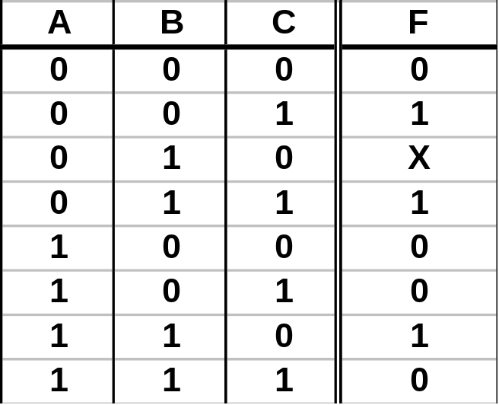
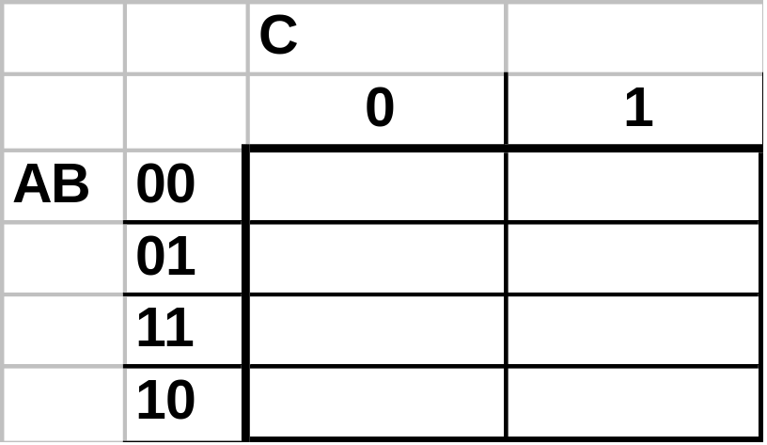
Karnaugh Maps
Find the Min POS for the following 3-variable function:
0
1
X
1
1
*
0
0
0
F=(C+B)
(A+C)
© Gamal Fahmy

